Slide 1
Influenza Vaccinations and Health Outcomes with BART
Fordham University - Observational Studies

Slide 2

Background
Center for Disease Control (CDC) estimates that between 9 and 45 million people have been infected with the influenza virus since 2010.
Influenza can result in illness causing infected persons to miss work, or worse in some circumstances
CDC cites practicing proper hygiene, staying away from others who are sick, and avoiding touching nose and mouth as preventative measures.
CDC also recommends vaccination as a preventative measure

Slide 3


Data Sources
The CDC conducts an annual survey called the Behavioral Risk Factor Surveillance System (BRFSS)
Aims to measure specific health behaviors and practices amongst the US population
Questions include a wide range of topics from general health, exercise frequency, and smoking patterns.

Slide 4
Outcome
Participants between December and March
Reports illness more than 5 days or more in the last 30 days were classified as a 1, and participants who were not sick any days were classified as a 0.
Participants who reports chronic or mental illness were filtered out

Slide 5
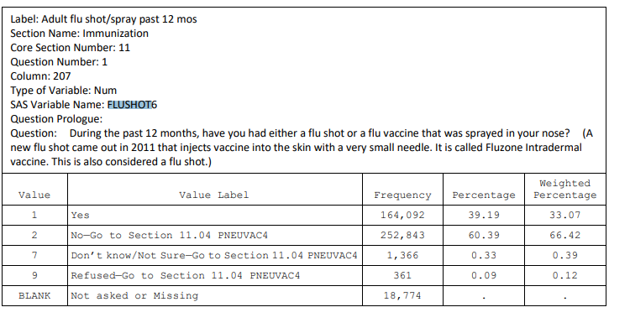
Survey Example

Slide 6
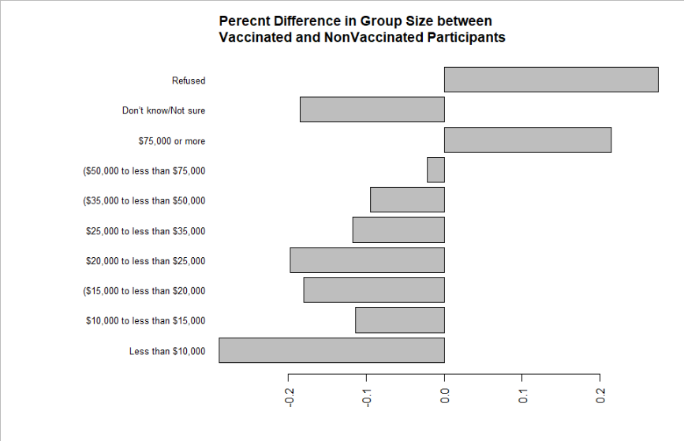
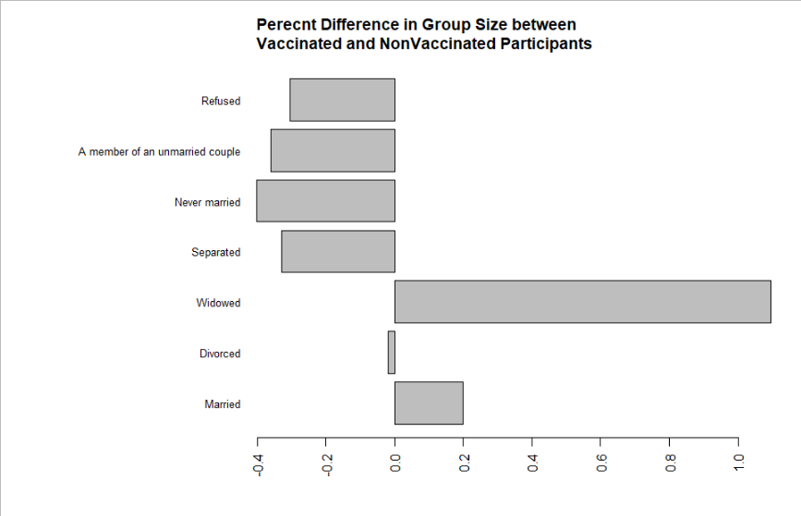
Data
Income
Marital Status

Slide 7
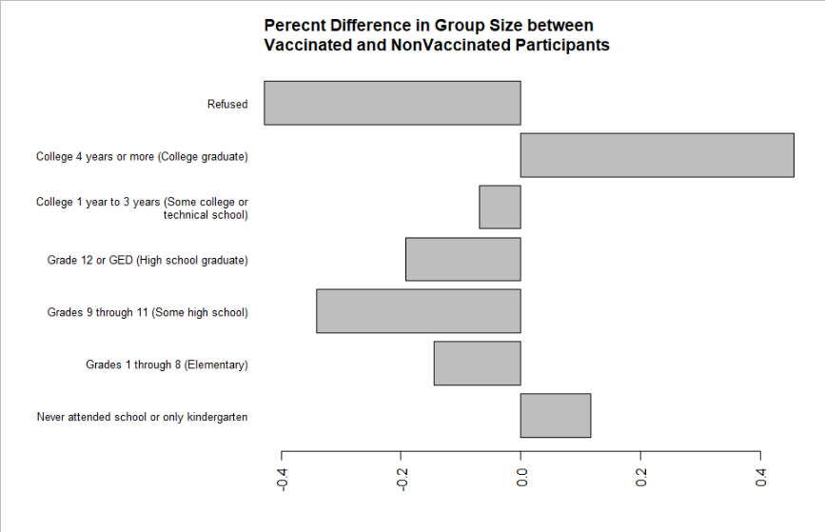
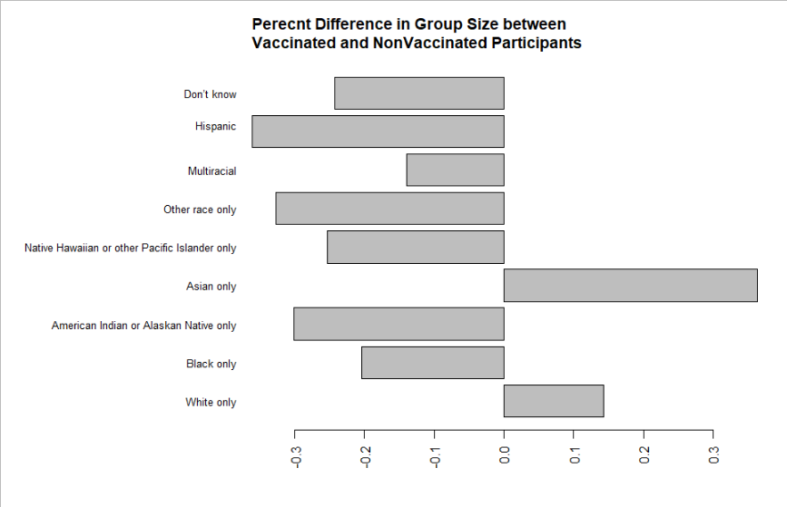
Data (cont.)
Education Level
Race

Slide 8
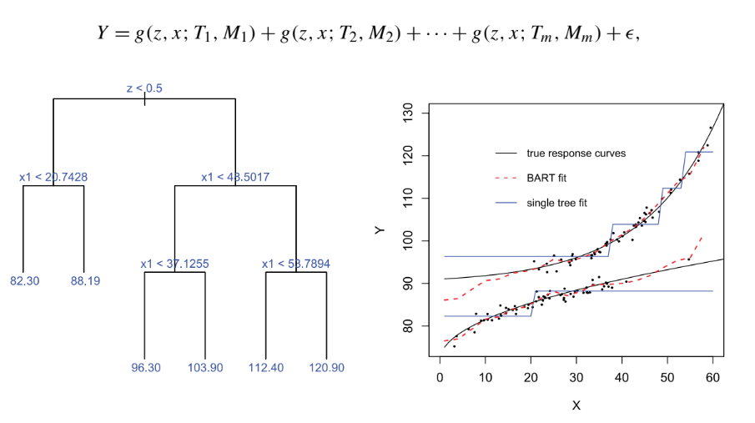
Bayesian Additive Regression Trees (BART)
Data is split treatment and non treatment
Different cuts are assigned for intervals for covariates (branches)
Weak learner → Boosted Model
Summed weak learners can be predictive

Slide 9
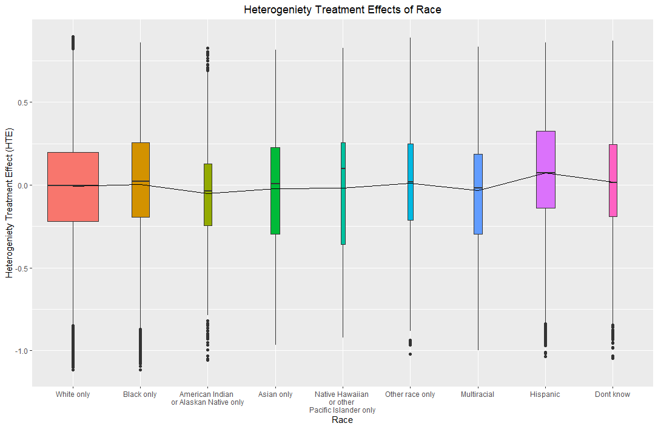
Results
No significant differences
ATE is small
ATT is small
HTE nothing large, race has some differences

Slide 10
Questions?

